Slide 1

Chapter 2: Instructions: Language of the Computer

Slide 2
Lecture 1: Instructions: Language of the Computer
Today’s topics:
The Five Classic Components of a Computer
Introduction
Operations of the Computer Hardware
Operands of the Computer Hardware
Chapter 2 — Instructions: Language of the Computer— by Hau Moy Kwan

Slide 3
Lecture 1: Instructions: Language of the Computer
The Five Classic Components of a Computer
• Processor(CPU)
• Main memory
• Secondary memory
• Input devices
• Output devices

Slide 4
Lecture 1: Instructions: Language of the Computer
Introduction
To command a computer’s hardware, you must speak its language. The words of a computer's language are called instructions, and its vocabulary is called an instruction set
instruction set: The vocabulary of commands understood by a given architecture
With instruction set, once you learn one, it is easy to pick up others
The chosen instruction set in this chapter is MIPS, which is an elegant
example of the instruction sets designed since the 1980s.

Slide 5
Lecture 1: Instructions: Language of the Computer
Operations of the Computer Hardware
Every computer must be able to perform arithmetic operations.
The MIPS assembly language notation is:
add a, b, c
instructs a computer to add the two variables b and c and to put their sum in a. All arithmetic operations have this form

Slide 6
Lecture 1: Instructions: Language of the Computer
Operations of the Computer Hardware
Examples: suppose we want to place the sum of four variables b, c, d, and e into variable a.

Slide 7
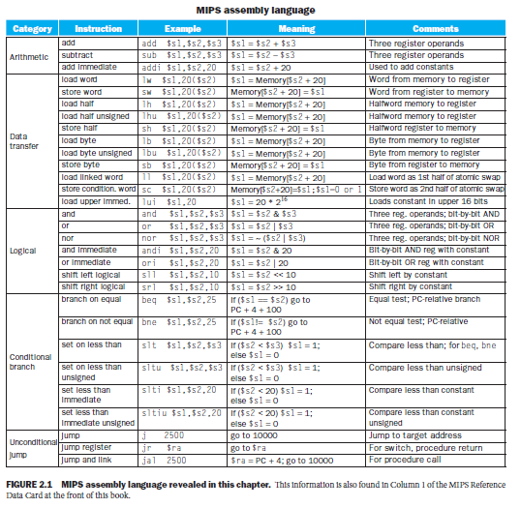
Lecture 1: Instructions: Language of the Computer
Operations of the Computer Hardware

Slide 8
Lecture 1: Instructions: Language of the Computer
Operations of the Computer Hardware
Design Principle 1: Simplicity favours regularity
Regularity makes implementation simpler
Simplicity enables higher performance at lower cost
Examples:

Slide 9
Lecture 1: Instructions: Language of the Computer
Operands of the Computer Hardware
Register Operands
2. Memory Operands
3. Constant or Immediate Operands

Slide 10
Lecture 1: Instructions: Language of the Computer
Operands of the Computer Hardware
Register Operands:
Unlike programs in high-level languages, the operands of arithmetic instructions are restricted; they must be from a limited number of special locations built directly in hardware called registers.
The size of a register in the MIPS architecture is 32 bits; groups of 32 bits occur so frequently that they are given the name word in the MIPS architecture. (note: a word in other instruction sets is able to not be 32 bits)
One major difference between the variables of a programming language and registers is the limited number of registers, typically 32 on current computers.
MIPS has 32 registers.

Slide 11
Lecture 1: Instructions: Language of the Computer
Operands of the Computer Hardware
Register Operands:
Design Principle 2: Smaller is faster.
A very large number of registers may increase the clock cycle time simply because it takes electronic signals longer when they must travel farther.

Slide 12
Lecture 1: Instructions: Language of the Computer
Register Operands. Example
Compiling a C Assignment Using Registers. It is the compiler’s job to associate program variables with registers. Take, for instance, the assignment statement from our earlier example:
f = (g + h) – (i + j);
The variables f, g, h, i, and j are assigned to the registers $s0, $s1, $s2, $s3, and $s4, respectively. What is the compiled MIPS code?

Slide 13
Lecture 1: Instructions: Language of the Computer
2. Memory Operands
Operands of the Computer Hardware
Memory Operands (1):
The processor can keep only a small amount of data in registers, but computer memory contains millions of data elements.
With MIPS instructions, arithmetic operations occur only on registers; thus, MIPS must include instructions that transfer data between memory and registers. Such instructions are called data transfer instructions.
Data transfer instruction: A command that moves data between memory and registers.
To access a word in memory, the instruction must supply the memory address
Address: A value used to delineate the location of a specific data element within a memory array.

Slide 14
Lecture 1: Instructions: Language of the Computer
Operands of the Computer Hardware
Memory Operands (2):
Memory is just a large, single-dimensional array, with the address acting as the index to that array, starting at 0. For example, in Figure 2, the address of the third data element is 2, and the value of Memory[2] is 10.
Fig.3 Actual MIPS memory addresses and contents of memory for those words.
Fig.2 Memory addresses and contents of memory at those locations.

Slide 15
Lecture 1: Instructions: Language of the Computer
Operands of the Computer Hardware
Memory Operands (3):
The data transfer instruction that copies data from memory to a register is traditionally called load. The format of the load instruction:
lw $s1,20($s2)
$s1: register to be loaded
• A constant (20) and register ($s2) used to access memory. The sum of the constant and the contents of the second register forms the memory address.

Slide 16
Lecture 1: Instructions: Language of the Computer
Operands of the Computer Hardware
Memory Operands (4):
Example for load.
Let’s assume that A is an array of 100 words and that the compiler has associated the variables g and h with the registers $s1 and $s2 as before. Let's also assume that the starting address, or base address of the array is in $s3. Compile this C assignment statement:
g = h + A[8];

Slide 17
Lecture 1: Instructions: Language of the Computer
Operands of the Computer Hardware
Memory Operands (5):
Alignment restriction
In MIPS, words must start at addresses that are multiples of 4. This requirement is called an alignment restriction, and many architectures have it.
- Computers divide into those that use the address of the leftmost or “big end” byte as the word address versus those that use the rightmost or “little end” byte. MIPS is in the Big Endian camp.

Slide 18
Lecture 1: Instructions: Language of the Computer
Operands of the Computer Hardware
Memory Operands (6):
The instruction complementary to load is traditionally called store; it copies data from a register to memory. The format of a store is
sw $s1,20($s2)
$s1: register to be stored
• A constant (20) and register ($s2) used to access memory. The sum of the constant and the contents of the second register forms the memory address.

Slide 19
Lecture 1: Instructions: Language of the Computer
Memory Operands (7):
Example for store.
Assume variable his associated with register $s2and the base address of the array A is in $s3. What is the MIPS assembly code for the C assignment statement below?
A[12] = h + A[8];

Slide 20
Lecture 1: Instructions: Language of the Computer
Constant or Immediate Operands.
Many times a program will use a constant in an operation
lw $t0, AddrConstant4($s1) # $t0 = constant 4
add $s3, $s3, $t0 # $s3 = $s3 + $t0 ($t0 == 4)
Notes:
❖ Although the MIPS registers considered here are 32 bits wide, there is a 64-bit version of the MIPS instruction set with 32 64-bit registers. To keep them straight, they are officially called MIPS-32 and MIPS-64.
(In this chapter, a subset of MIPS-32 is used; see more MIPS-64 in Appendix E)
❖ Since MIPS supports negative constants, there is no need for subtract immediate in MIPS

Slide 21
Lecture 1: Instructions: Language of the Computer
Next Class …….
Topics:
Signed and Unsigned Numbers
Representing Instructions in the Computer
Instructions for Making Decisions

Slide 22
Bullet

